Slide 1

Instacart Grocery Basket Analysis
Analyze Instacart Database
Identify Purchasing Behaviors
Determine Sales Patterns
Suggest Targeted Strategy

Slide 2
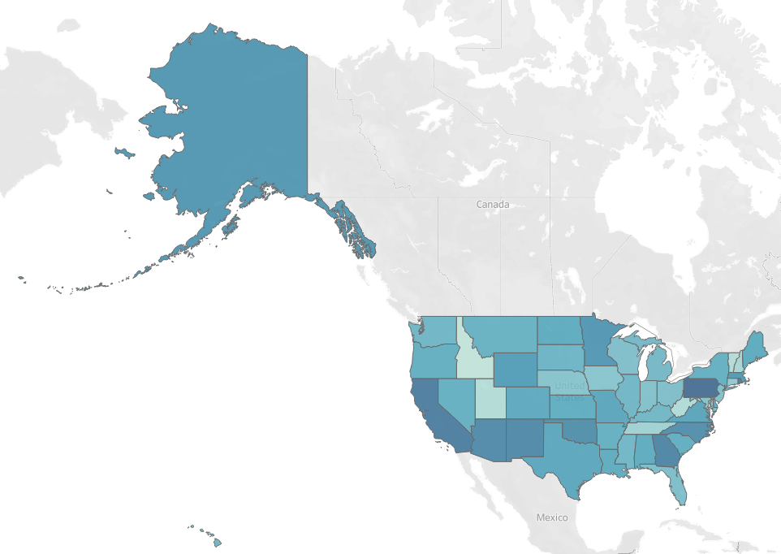
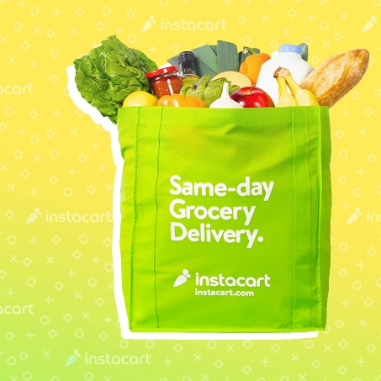

Instacart Systemwide Metrics & Benchmarks
Northeast (9) |  |  |  | 5,728,347
Maine, New Hampshire, Vermont
Massachusetts, Rhode Island, Connecticut
New York, New Jersey, Pennsylvania
Midwest (12) |  |  |  | 7,603,810
Wisconsin, Michigan, Illinois, Indiana, Ohio
North Dakota, South Dakota, Kansas, Iowa
Nebraska, Missouri, Minnesota
South (17) |  |  |  | 10,801,610
Delaware, Maryland, DC, Virginia, West Virginia
North Carolina, South Carolina, Georgia, Florida
Kentucky, Tennessee, Mississippi, Alabama
Oklahoma, Texas, Arkansas, Louisiana
West (13) |  |  |  | 8,300,445
Idaho, Montana, Wyoming, Nevada, Utah
Colorado, Arizona, New Mexico, Alaska
Washington, Oregon, California, Hawaii
 |  |  | Total | 32,434,212
 |  |  | Days Since
 |  | Avg. Order | Prior Order
Male | 16,329,623 | $19.39 | 11.13
Female | 16,104,589 | $19.39 | 11.09
Total | 32,434,212
Demographic data indicates that 50% of all orders are placed by females and 50% placed by males.
Geographical data shows no severe customer concentration with all states generating orders within a tight range of 607,811 to 667,710.
Established purchasing patterns and reorder activity has helped to set the bar as a gauge to measure efforts to generate new incremental sales for underperforming sectors.

Slide 3

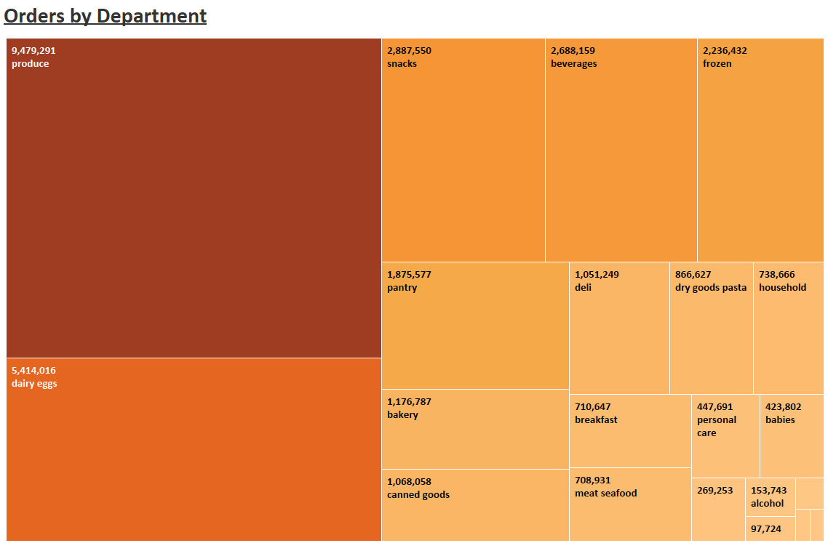

Departments | Orders |  | Avg. Price
Produce | 9,479,291 | 29% | $19.52
Dairy eggs | 5,414,016 | 17% | $19.40
Snacks | 2,887,550 | 9% | $18.81
Beverages | 2,688,159 | 8% | $18.63
Frozen | 2,236,432 | 7% | $19.44
Pantry | 1,875,577 | 6% | $19.57
Bakery | 1,176,787 | 4% | $19.63
Canned goods | 1,068,058 | 3% | $19.85
Deli | 1,051,249 | 3% | $19.44
Dry goods pasta | 866,627 | 3% | $19.91
Household | 738,666 | 2% | $18.83
Breakfast | 710,647 | 2% | $18.94
Meat seafood | 708,931 | 2% | $21.81
Personal care | 447,691 | 1% | $18.85
Babies | 423,802 | 1% | $20.06
International | 269,253 | 1% | $19.67
Alcohol | 153,743 | 0% | $17.74
Pets | 97,724 | 0% | $19.36
Missing | 69,145 | 0% | $19.22
Other | 36,291 | 0% | $18.92
Bulk | 34,573 | 0% | $18.70
Total | 32,434,212 | 100%
The 4 most popular departments of Produce, Dairy, Snacks & Beverages make up 63% of total orders.
3 of the highest priced departments of Meat/Seafood, Pasta & Canned Goods comprise only 8% of orders.

Slide 4
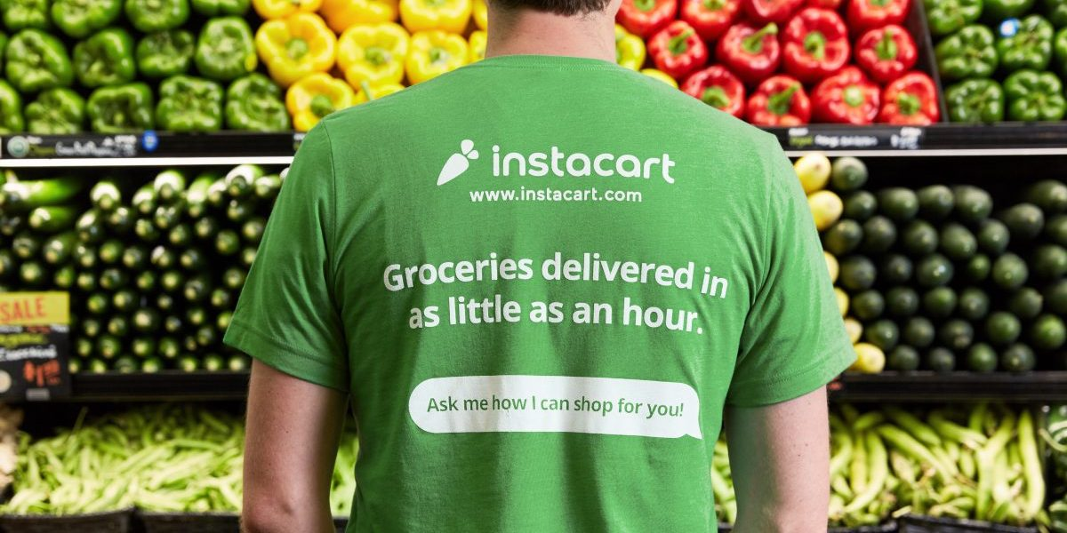
Daily Trends (by the hour)
Time | Orders
9:00 AM | 2,456,661
10:00 AM | 2,764,390
11:00 AM | 2,738,585
12:00 PM | 2,620,800
1:00 PM | 2,663,272
2:00 PM | 2,691,563
3:00 PM | 2,664,522
4:00 PM | 2,537,469
5:00 PM | 2,089,452
6:00 PM | 1,637,922
7:00 PM | 1,259,382
8:00 PM | 977,017
9:00 PM | 796,362
10:00 PM | 634,737
11:00 PM | 402,612
12:00 AM | 218,942
1:00 AM | 115,786
2:00 AM | 69,431
3:00 AM | 51,317
4:00 AM | 53,283
5:00 AM | 88,057
6:00 AM | 290,770
7:00 AM | 891,928
8:00 AM | 1,719,952
Total | 32,434,212
Day | Orders
Saturday | 6,209,632
Sunday | 5,665,830
Monday | 4,217,766
Tuesday | 3,844,096
Wednesday | 3,787,193
Thursday | 4,209,449
Friday | 4,500,246
Total | 32,434,212
- The majority of orders are placed between the hours of 9:00 AM through 5:00 PM and then drop off precipitously throughout the rest of the day!
- Orders peak significantly on the weekends and then drop off drastically on weekdays!

Slide 5

Customers based on Income
Income | Orders
Over 155,000 | 3,145,347 | 10%
52,000 to 155,000 | 25,405,239 | 78%
Under 52,000 | 3,883,626 | 12%
Total | 32,434,212
 | Over $155,000 | $52,000 to $155,000 | Under $52,000 | Benchmark
Average Order | $19.81 | $19.71 | $16.96 | $19.39
Days since Prior Order | 10.92 | 11.05 | 11.57 | 11.10
Departments | Orders
Produce | 962,369
Snacks | 627,785
Dairy eggs | 581,171
Beverages | 431,760
Frozen | 252,569
Pantry | 194,803
Bakery | 125,969
Deli | 122,828
Breakfast | 105,035
Household | 100,505
Canned goods | 94,979
Dry goods pasta | 77,703
Personal care | 55,549
Meat seafood | 41,498
Babies | 34,985
International | 25,396
Alcohol | 21,076
Pets | 10,121
Missing | 7,832
Bulk | 5,215
Other | 4,478
Total | 3,883,626
Products (popular with) and purchased by customers with Income under $52,000
Customers with Income under $52,000:
make up only 12% of total orders
generate an average order of only $16.96
re-order every 11.57 days
underperform all key metrics

Slide 6
Customers based on Frequency
Frequency | Orders
Loyal (more than 40 orders) | 10,293,737 | 32%
Regular | 15,891,077 | 49%
New (10 or less orders) | 6,249,398 | 19%
Total | 32,434,212
 | Loyal | Regular | New | Benchmark
Average Order | $20.37 | $19.48 | $17.57 | $19.39
Days since Prior Order | 6.03 | 12.16 | 17.98 | 11.10
Departments | Orders
Produce | 1,736,622
Dairy eggs | 974,289
Snacks | 534,251
Beverages | 512,883
Frozen | 485,655
Pantry | 392,306
Canned goods | 236,180
Bakery | 224,397
Deli | 205,750
Dry goods pasta | 189,327
Household | 166,926
Meat seafood | 146,612
Breakfast | 139,909
Personal care | 98,734
Babies | 60,118
International | 57,103
Alcohol | 37,716
Pets | 20,540
Missing | 17,090
Other | 7,719
Bulk | 5,271
Total | 6,249,398
Products (popular with) and purchased by New Customers
New Customers:
make up only 19% of total orders
generate an average order of only $17.57
re-order every 17.98 days
underperform all key metrics

Slide 7
Customers based on Marital Status
Marital Status | Orders
Married | 22,776,913 | 70%
Divorced/Widowed | 2,774,428 | 9%
Living with Parents/Siblings | 1,552,102 | 5%
Single | 5,330,769 | 16%
Total | 32,434,212
 | Married | Divorced/Widowed | Living with Parents/Siblings | Single | Benchmark
Average Order | $19.39 | $19.44 | $19.38 | $19.38 | $19.39
Days since Prior Order | 11.12 | 11.05 | 11.05 | 11.10 | 11.10
Departments | Orders
Produce | 1,562,611
Dairy eggs | 890,014
Snacks | 474,002
Beverages | 443,423
Frozen | 363,897
Pantry | 306,828
Bakery | 194,818
Canned goods | 175,579
Deli | 174,327
Dry goods pasta | 141,042
Household | 118,968
Breakfast | 116,377
Meat seafood | 113,607
Personal care | 73,491
Babies | 71,168
International | 44,653
Alcohol | 26,509
Pets | 16,174
Missing | 11,595
Other | 6,173
Bulk | 5,513
Total | 5,330,769
Products (popular with) and purchased by Single Customers
Single Customers:
make up only 16% of total orders
generate an average order of only $19.38
re-order every 11.10 days
Small percentage of total order activity

Slide 8
Customers based on Age
Age | Orders
Over 60 | 11,077,150 | 34%
35 to 60 | 12,721,565 | 39%
Under 35 | 8,635,497 | 27%
Total | 32,434,212
 | Over 60 | 35 to 60 | Under 35 | Benchmark
Average Order | $19.39 | $19.39 | $19.39 | $19.39
Days since Prior Order | 11.10 | 11.10 | 11.12 | 11.10
Departments | Orders
Produce | 2,520,232
Dairy eggs | 1,449,362
Snacks | 772,504
Beverages | 708,110
Frozen | 592,264
Pantry | 499,293
Bakery | 313,930
Canned goods | 285,891
Deli | 279,021
Dry goods pasta | 231,863
Household | 194,619
Breakfast | 191,084
Meat seafood | 188,162
Personal care | 118,276
Babies | 111,092
International | 72,639
Alcohol | 42,625
Pets | 26,381
Missing | 18,977
Other | 9,870
Bulk | 9,302
Total | 8,635,497
Products (popular with) and purchased by customers under the age of 35
Customers under the age of 35:
make up only 27% of total orders
generate an average order of $19.39
re-order every 11.12 days
Small percentage of total order activity

Slide 9

Insights & Recommendations
 | Saturday | Sunday | Monday | Tuesday | Wednesday | Thursday | Friday
9:00 AM | 470,335 | 429,146 | 319,466 | 291,163 | 286,853 | 318,836 | 340,862
10:00 AM | 529,251 | 482,903 | 359,483 | 327,635 | 322,785 | 358,774 | 383,559
11:00 AM | 524,311 | 478,395 | 356,127 | 324,577 | 319,772 | 355,425 | 379,979
12:00 PM | 501,760 | 457,819 | 340,811 | 310,617 | 306,019 | 340,138 | 363,636
1:00 PM | 509,892 | 465,239 | 346,334 | 315,650 | 310,978 | 345,651 | 369,529
2:00 PM | 515,308 | 470,181 | 350,013 | 319,003 | 314,281 | 349,322 | 373,454
3:00 PM | 510,131 | 465,457 | 346,496 | 315,799 | 311,124 | 345,813 | 369,702
4:00 PM | 485,806 | 443,262 | 329,974 | 300,740 | 296,289 | 329,323 | 352,074
5:00 PM | 400,032 | 365,000 | 271,714 | 247,641 | 243,976 | 271,178 | 289,911
6:00 PM | 313,585 | 286,123 | 212,996 | 194,126 | 191,253 | 212,576 | 227,262
7:00 PM | 241,113 | 219,997 | 163,771 | 149,262 | 147,052 | 163,448 | 174,739
8:00 PM | 187,053 | 170,672 | 127,052 | 115,796 | 114,082 | 126,801 | 135,561
9:00 PM | 152,466 | 139,114 | 103,559 | 94,385 | 92,988 | 103,355 | 110,495
10:00 PM | 121,522 | 110,880 | 82,542 | 75,229 | 74,115 | 82,379 | 88,070
11:00 PM | 77,081 | 70,331 | 52,356 | 47,717 | 47,011 | 52,253 | 55,862
12:00 AM | 41,917 | 38,246 | 28,471 | 25,949 | 25,565 | 28,415 | 30,378
1:00 AM | 22,168 | 20,226 | 15,057 | 13,723 | 13,520 | 15,027 | 16,065
2:00 AM | 13,293 | 12,129 | 9,029 | 8,229 | 8,107 | 9,011 | 9,634
3:00 AM | 9,825 | 8,964 | 6,673 | 6,082 | 5,992 | 6,660 | 7,120
4:00 AM | 10,201 | 9,308 | 6,929 | 6,315 | 6,222 | 6,915 | 7,393
5:00 AM | 16,859 | 15,382 | 11,451 | 10,436 | 10,282 | 11,428 | 12,218
6:00 AM | 55,669 | 50,794 | 37,812 | 34,462 | 33,952 | 37,737 | 40,344
7:00 AM | 170,762 | 155,808 | 115,987 | 105,711 | 104,146 | 115,758 | 123,755
8:00 AM | 329,290 | 300,453 | 223,664 | 203,848 | 200,831 | 223,223 | 238,643
Total | 6,209,632 | 5,665,830 | 4,217,766 | 3,844,096 | 3,787,193 | 4,209,449 | 4,500,246 | 32,434,212
 | Underperforming Hours & Days: |  | 1,469,063 | 1,338,912 | 1,319,093 | 1,466,166 | 1,567,451 | 7,160,685
Significant opportunities exist to generate incremental sales in under performing sectors
Weekday orders lag the weekend
There is a severe drop off in activity during the hours of 5:00 PM - 9:00 AM
A huge opportunity for increased orders exists during this time period as it currently accounts for only 7,160,685 orders
Key metrics indicate that the following demographics under perform:
- Income below $52,000
- New Customers
- Single
- Under 35 years old
- These 4 groups total 17,608,299 orders (54%)
A focused effort should be made to target the underperforming demographics with meaningful offers to improve and increase order activity (avg. orders & frequency).
These offers should be made during the Underperforming Hours and Days (of the week).
These offers should be for the most popular items and the most expensive items so as to incentivize use during slow periods.

